Slide 1

Module : EMBEDDED SYSTEM & HARDWARE INTERFACING
Prepared by : Muhammad Syahmi

Slide 2
Circuit Design and Simulation

Slide 3
By the end of this course
dada

Slide 4
What is thinkercad
Tinkercad is an open source and a free web based online collection of software tools and it only requires an internet connection and a web browser.
Tinkercad provides us easy 3D design creation, code blocks programming and electronic circuits simulation
In the Circuits section (we use this section) of Tinkercad, you can design your circuit in the easiest manner and can simulate your circuit using an Arduino or other boards or components available, with and without any knowledge of computer codes or programming.
In the 3D design of Tinkercad, you don’t need prior knowledge of CAD. It is easy to create 3D designs you like.
In code blocks of Tinkercad, you can design 3D objects not only using drag and drop of shapes but also using visual code blocks.
.

Slide 5
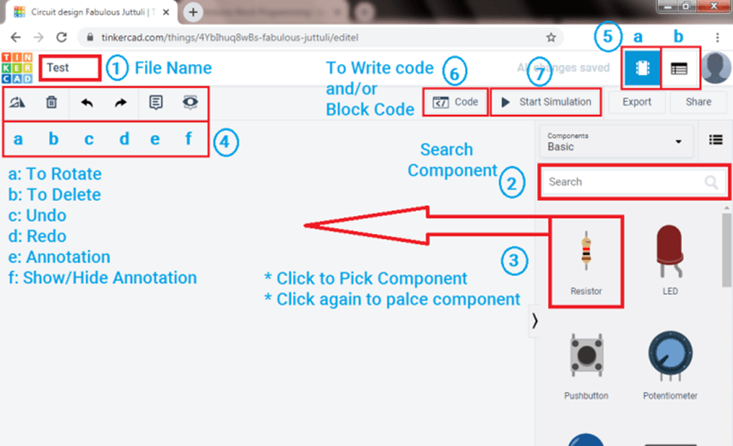
Circuits dashboard start guide

Slide 6
To get started
https://github.com/syahmisanab/beginner-rp2040-micropython
Please download source code from above

Slide 7
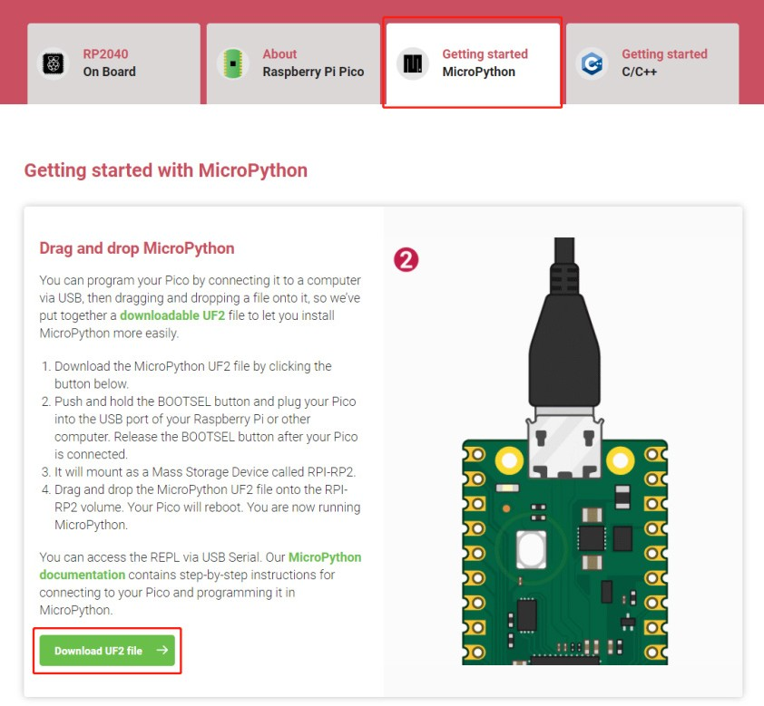
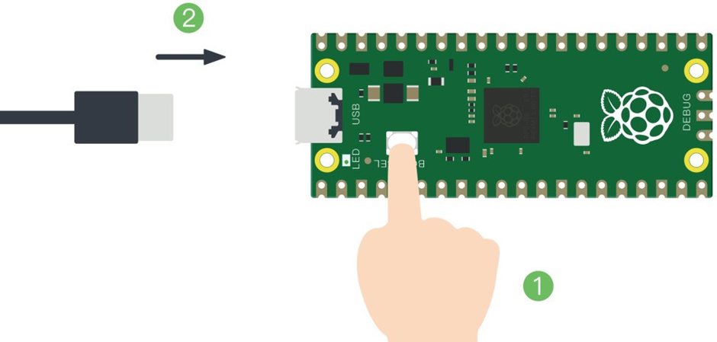
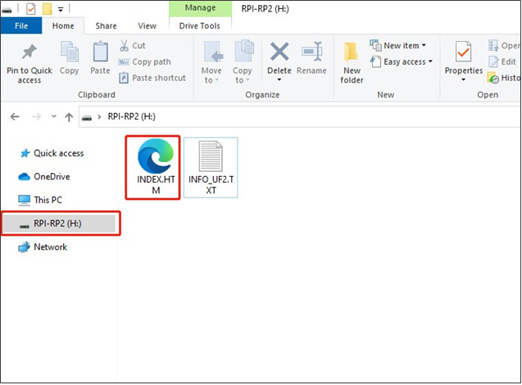
Rp2040 setup
Press boot button on the rp2040 and connect rp2040 with your computer
Rp2040 will look like this. Click on index.htm
Download UF2 files from the raspberry pi website

Slide 8


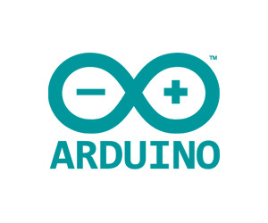
IDE software
Integrated Development Environment (IDE) is a software tool that provides an integrated environment for writing, editing, and developing MicroPython code.
Why we need IDE? What an IDE do?
To get started, download thonny

Slide 9
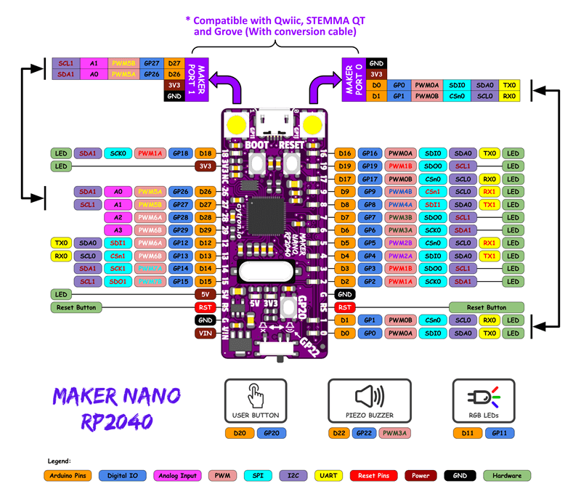

Slide 10
GND : Short for ‘Ground’. Its used to ground your circuit.
5V & 3.3V : the 5V pin supplies 5 volts of power, and the 3.3V pin supplies 3.3 volts of power.
Analog : The area of pins under the ‘Analog In’ label are Analog In pins. These pins can read the signal from an analog sensor (like a temperature sensor) and convert it into a digital value that we can read.
Digital : Across from the analog pins are the digital pins (0 through 13 on the UNO). These pins can be used for both digital input (like telling if a button is pushed) and digital output (like powering an LED).
PWM : These pins act as normal digital pins, but can also be used for something called Pulse-Width Modulation (PWM). think of these pins as being able to simulate analog output (like fading an LED in and out).
UART: Universal Asynchronous Receiver Transmitter. It is a communication protocol used for serial communication between devices.
SDL: Serial Data Line. It is one of the lines used in the I2C (Inter-Integrated Circuit) communication protocol for data transmission.
SDA: Serial Data Line. It is another line used in the I2C communication protocol for data transmission.
RST: Reset. It is a signal or line used to reset a device or circuit.
RX: Receive. It is the input line used to receive data in serial communication.
TX: Transmit. It is the output line used to transmit data in serial communication.

Slide 11
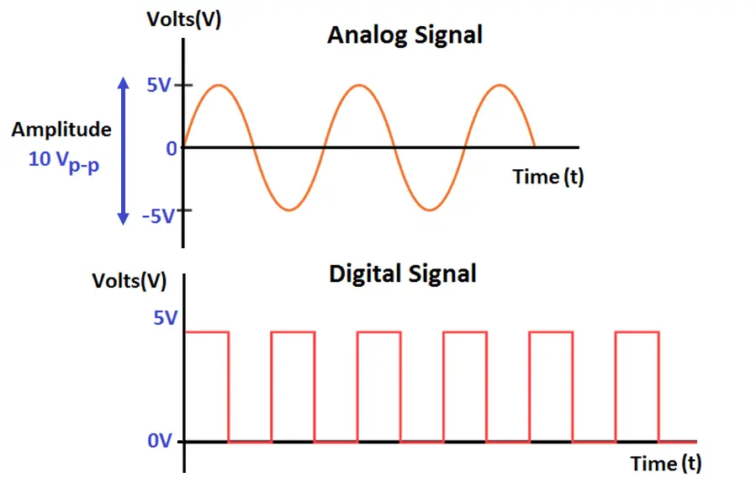
Digital GPIO
Introduction to GPIO
General-Purpose Input Output (GPIO) is a digital pin of an IC. It can be used as input or output for interfacing devices.
If we want to read the switch’s state, sensor data, etc then we need to configure it as input. And if we want to control the LED brightness, motor rotation, show text on display, etc then we need to configure it as output.
Digital Output
digital pins can be configured as output to drive output devices.
Digital Input
read data from senor or from any device/circuit

Slide 12
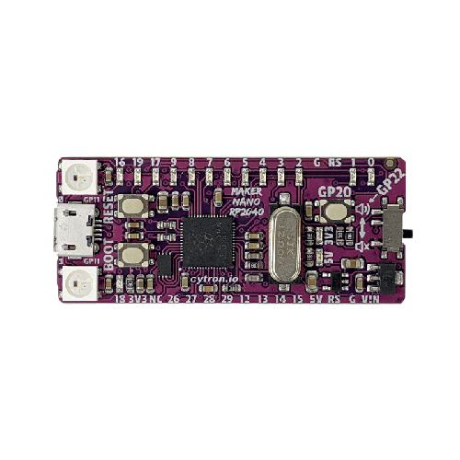
project 1 : Light up onboard LED
Onboard LED GP 2-9,16-19
import machine
import time
led_pin = machine.Pin(7, machine.Pin.OUT)
while True:
led_pin.on() # Turn the LED on
time.sleep(1) # Wait for 1 second
led_pin.off() # Turn the LED off
time.sleep(1) # Wait for 1 second
Let's create a simple project that makes the onboard LED blink on and off.

Slide 13
Project 2 : button
Onboard LED GP 2-9,16-19
import machine
led_pin = machine.Pin(2, machine.Pin.OUT)
button_pin = machine.Pin(4, machine.Pin.IN, machine.Pin.PULL_UP)
while True:
if not button_pin.value(): # If the button is pressed
led_pin.toggle() # Toggle the LED state
while not button_pin.value(): # Wait until the button is released
pass
Button GP20
Let's create a simple project that makes the onboard LED blink on and off with help of button

Slide 14
Project 3 : buzzer

Slide 15
analog signal
Analog Signal
An analog signal is a type of signal that represents information through continuously changing physical properties, such as voltage or current. Unlike digital signals that use discrete values (0s and 1s), analog signals vary smoothly and continuously over time
ADC
ADC, or Analog-to-Digital Converter, plays a crucial role when interfacing sensors with microcontrollers. Often, sensor outputs are analog, while microcontrollers process digital signals. To bridge this gap, an ADC is used to convert the analog signal into a digital format before passing it to the microcontroller

Slide 16
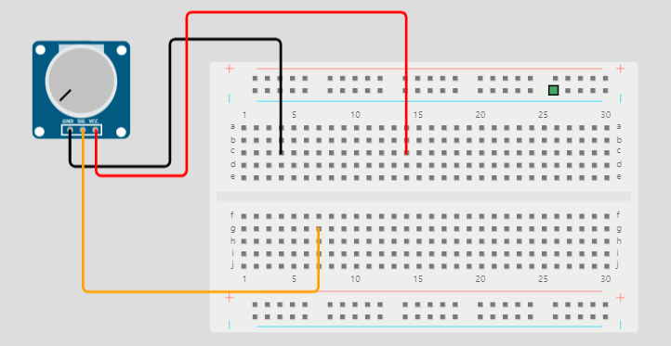
Project 4 : potentiometer
VCC = 3V3
GND = GND
SIGNAL = GPIO

Slide 17
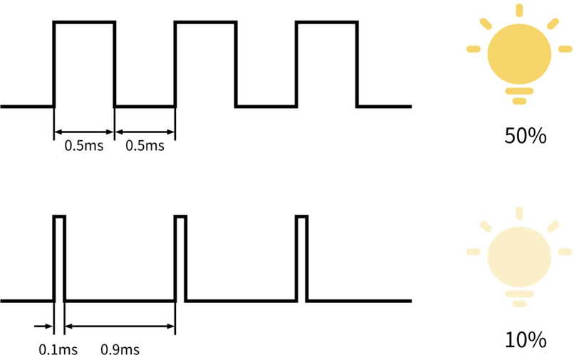
PWM
Introduction to PWM
Pulse Width Modulation (PWM) is a technique by which width of a pulse is varied while keeping the frequency of the wave constant. It is a method for generating an analog signal using a digital source.

Slide 18
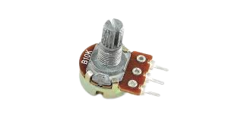
Project 4 : nonpixel led
By using onboard neopixle and potentiometer. control color of nonpixel led
Gnd
Output
vcc

Slide 19
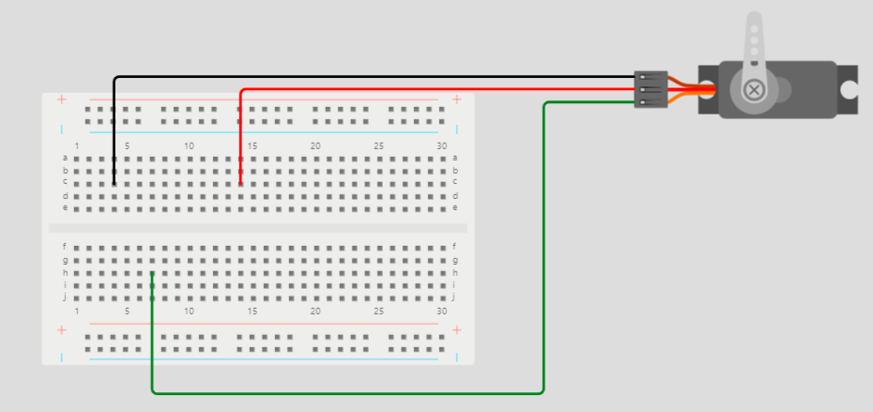
Project 5 : servo control
VCC = 3V3
GND = GND
SIGNAL = PWM

Slide 20
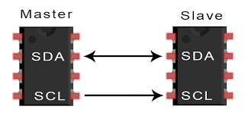
I2C
Introduction to I2C
I2C (Inter-Integrated Circuit) is a serial bus interface connection protocol. It is also called a TWI (two wire interface) since it uses only two wires for communication. Those two wires are SDA (serial data) and SCL (serial clock).
I2C is an acknowledgment-based communication protocol i.e. transmitter checks for an acknowledgment from the receiver after transmitting data to know whether data is received by the receiver successfully.

Slide 21
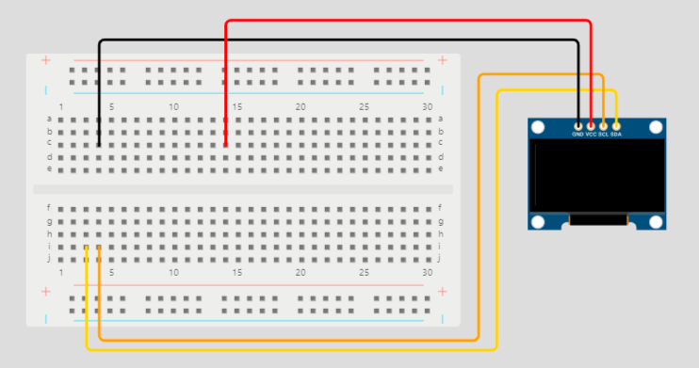
Project 5 : oled display
VCC = 3V3
GND = GND
SDA = 0
SCL = 1

Slide 22
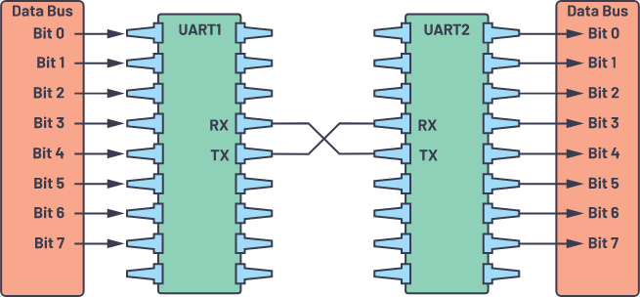
UART
What is USART?
USART (Universal Serial Asynchronous Receiver Transmitter) is a serial communication protocol used to transmit/receive data serially at a specific baud rate.

Slide 23
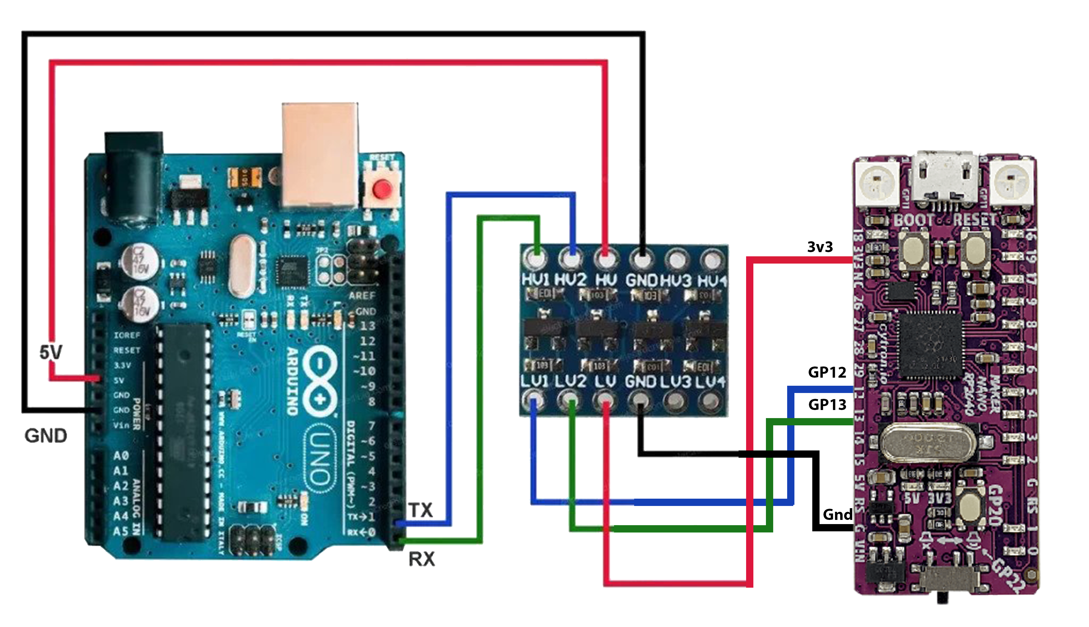
Serial communication rp2040 and arduino
/

